Slide 1

Chapter 03-[2]
Working with Contents
Notes:
Session: Ghi số thứ tự session trong môn học
Session Name: ghi tên của session sẽ dạy

Slide 2
Objectives
Content components in Bootstrap 4 are reserved for the most commonly used HTML elements such as images, tables, typography, and more. In this chapter, We’ll learn:
Reboot defaults and basics
Learning to use typography
Customizing headings
How to style images
Coding tables
Notes:
Mô tả nội dung mà học viên phải đạt được khi kết thúc môn học này

Slide 3
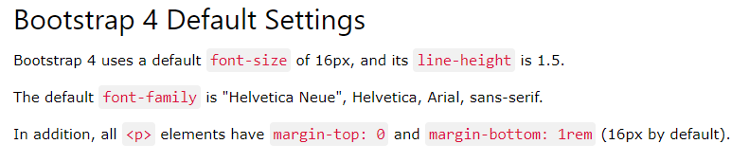
Reboot defaults and basics
file:///E:/IVietTech/Front%20End-2017/Web%20Design/Codes/bootstrap-4.0.0-beta.2/dist/css/bootstrap-reboot.css
Notes:
Session: Ghi số thứ tự session trong môn học
Session Name: ghi tên của session sẽ dạy

Slide 4
Reboot defaults and basics
One of the main changes for content components in Bootstrap 4 is the switch from em to rem units of measure.
The rem unit is not relative to its parent, it is relative to the root or HTML element.
The box-sizing property is globally set to border-box on every element.
The base font-size for Bootstrap 4 is 16px and it is declared on the html element. On the body element, the font-size is set to 1rem for easy responsive type-scaling when using media queries.

Slide 5
Reboot defaults and basics
There are also global font-family and line-height values set on the body tag for consistency through all components. By default, the background-color is set to #fff or white on the body selector.
All heading elements have been reset to have their top-margin removed. Headings have a margin-bottom value of 0.5rem, while paragraphs have a margin-bottom value of 1rem.

Slide 6
Reboot defaults and basics
The list component comes in three variations: <ul>, <ol>, and <dl>. Each list type has had its top-margin removed and has a bottom-margin of 1rem.
The table component has been adjusted slightly to ensure consistent text alignment in all cells. The styles for the <caption> tag have also been adjusted a bit for better legibility.
The form component is much simpler in Bootstrap 4. Much of the default styling has been removed to make the component easier to use and customize.

Slide 7
Learning to use typography
Notes:
Session: Ghi số thứ tự session trong môn học
Session Name: ghi tên của session sẽ dạy

Slide 8
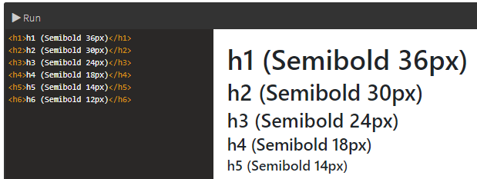
Using display headings
Regular header tags work great in the flow of a page and are key for setting up the hierarchy of an article. Here's a sample of heading elements as they appear in Bootstrap 4:

Slide 9
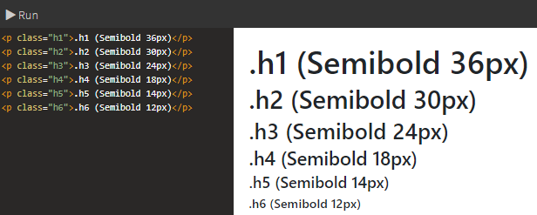
Using display headings
Bootstrap also includes heading classes from .h1 to .h6 in case you need to render some inline text in the style of a particular heading

Slide 10
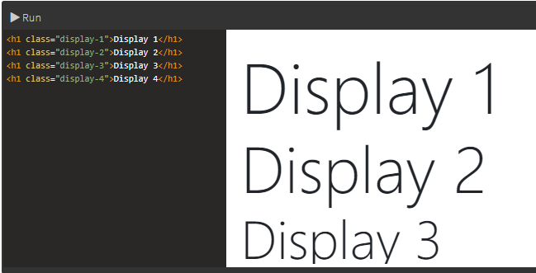
Using display headings
Display headings are designed to stand out more than the normal headings. There are 4 sizes of display heading (.display-1, .display-2, .display-3, and .display-4).
Notes:
https://www.quackit.com/bootstrap/bootstrap_4/tutorial/bootstrap_typography.cfm

Slide 11
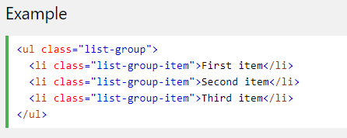
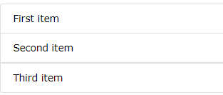
Working with lists
Basic List Groups: The most basic list group is an unordered list with list items. To create a basic list group, use an <ul> element with class .list-group, and <li> elements with class .list-group-item:
Notes:
https://www.w3schools.com/bootstrap4/bootstrap_list_groups.asp

Slide 12
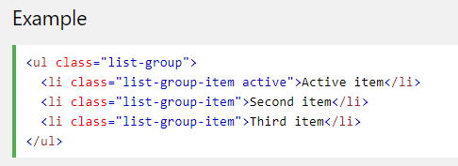
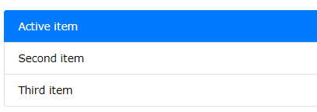
Working with lists
Active State: Use the .active class to highlight the current item.

Slide 13
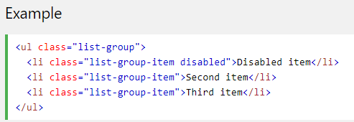
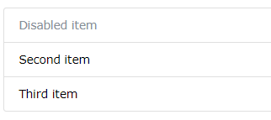
Working with lists
Disabled Item: To disable an item, add the .disabled class:

Slide 14
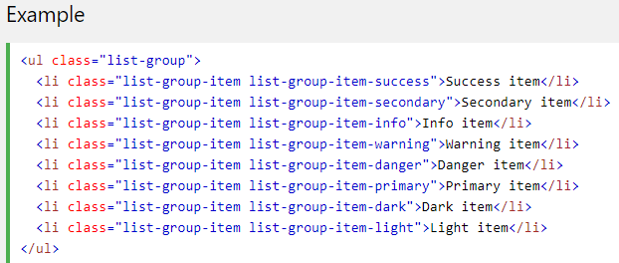
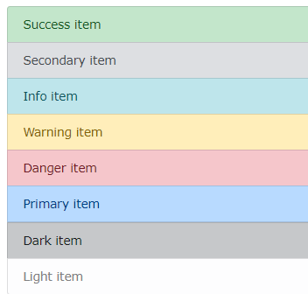
Working with lists
Contextual Classes: Contextual classes can be used to color list items. The classes for coloring list-items are: .list-group-item-success, list-group-item-secondary, list-group-item-info, list-group-item-warning, .list-group-item-danger, list-group-item-dark and list-group-item-light:

Slide 15
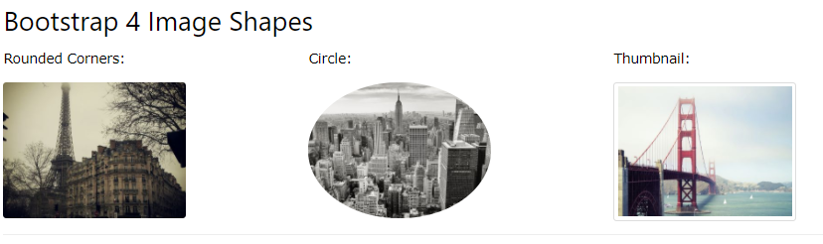
How to style images
Notes:
https://www.quackit.com/bootstrap/bootstrap_4/tutorial/bootstrap_images.cfm

Slide 16
Responsive Images
Bootstrap 4 comes with a new responsive image class that is super-handy when developing websites or web-based applications. When applying the class img-fluid to an <img> tag, it will automatically set the max-width of the image to 100% and the height to auto.
<img src="myimage.jpg" class="img-fluid" alt="Responsive Image">

Slide 17
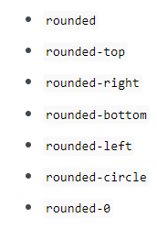
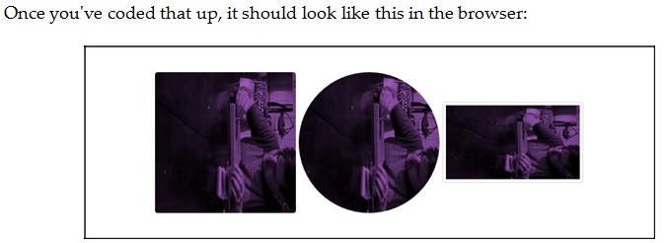
Using image shapes
Bootstrap allows you to apply three different shape styles to images: .rounded , rounded-circle and img-thumbnail
<img src="myimage.jpg" class=“rounded" alt="Responsive Image">
<img src="myimage.jpg" class=“rounded-circle" alt="Responsive Image">
<img src="myimage.jpg" class=“img-thumbnail" alt="Responsive Image">

Slide 18
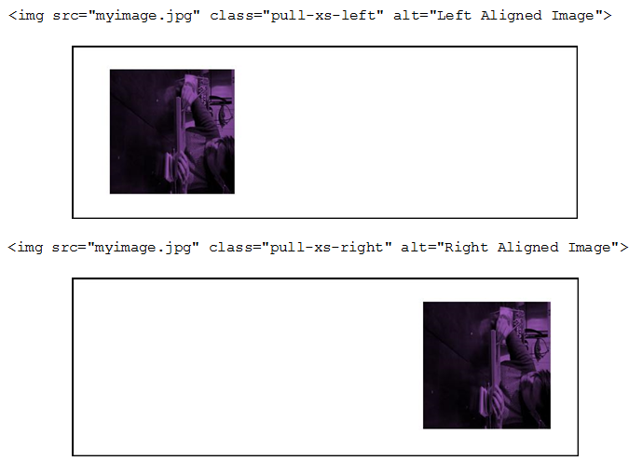
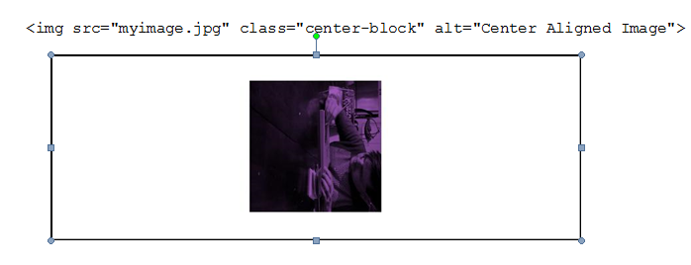
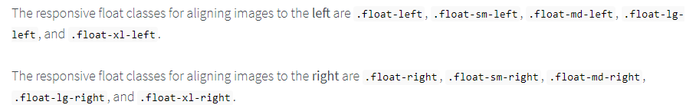
Aligning images with CSS
Notes:
https://www.quackit.com/bootstrap/bootstrap_4/tutorial/bootstrap_images.cfm

Slide 19
Coding tables
https://www.w3schools.com/bootstrap4/bootstrap_tables.asp
Notes:
Session: Ghi số thứ tự session trong môn học
Session Name: ghi tên của session sẽ dạy

Slide 20
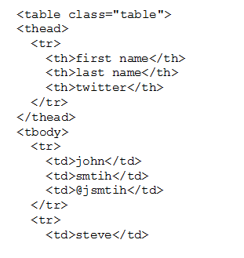
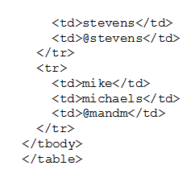
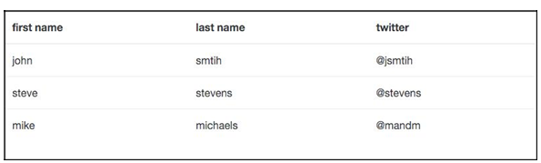
Setting up the basic table
The basic table structure in Bootstrap takes advantage of almost all the available HTML table tags.
Notes:
https://www.w3schools.com/bootstrap4/bootstrap_tables.asp

Slide 21

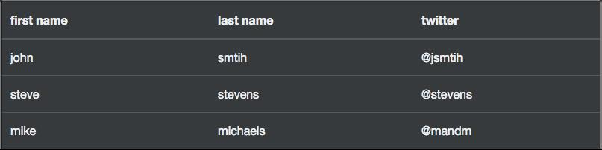
Inverting a table
Let me quickly show you one of the new table classes in Bootstrap 4. If we add the class table-inverse to the <table> tag, the table colors will flip to be a dark background with light text.
Notes:
https://www.w3schools.com/bootstrap4/bootstrap_tables.asp

Slide 22
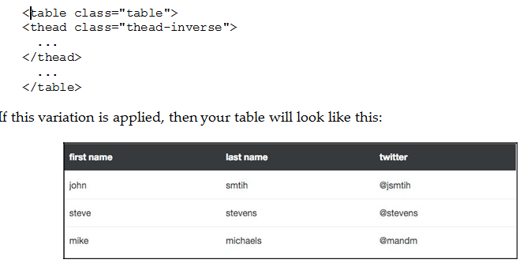
Inversing the table header
Perhaps you don't want to inverse the entire table? If that is the case, you can use the thead-inverse class on the <thead> tag to only inverse that row:
Notes:
https://www.w3schools.com/bootstrap4/bootstrap_tables.asp

Slide 23
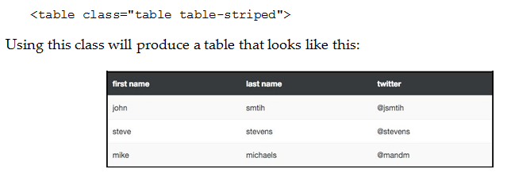
Adding striped rows
Although not new to Bootstrap 4, the table-striped class is one that I use all the time. Applying this class to the <table> tag will add zebra striping to your table, starting with the first row in the body and applying a light grey background color on all the odd numbered rows:
Notes:
https://www.w3schools.com/bootstrap4/bootstrap_tables.asp

Slide 24
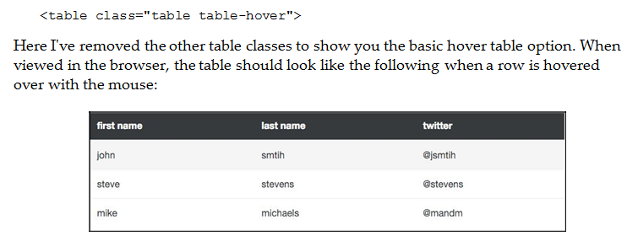
Adding a hover state to rows
It's possible and easy to add a hover state to each of your table rows. To do so, you just need to add the table-hover class to the <table> tag.
Notes:
https://www.w3schools.com/bootstrap4/bootstrap_tables.asp

Slide 25
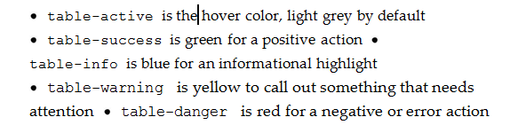
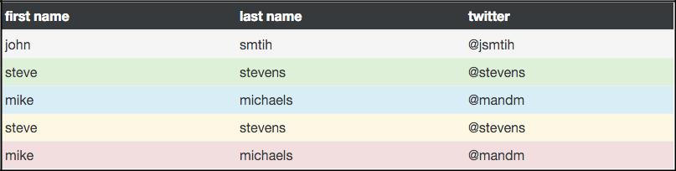
Color-coating table rows
In some cases, you may want to color the background of a table row in a different color. This can easily be achieved through the use of some included contextual classes. There are five different color variations you can choose from:
Notes:
https://www.w3schools.com/bootstrap4/bootstrap_tables.asp

Slide 26
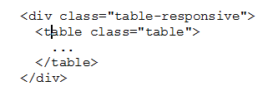
Making tables responsive
Adding responsiveness to tables has never been very easy to do with CSS.
To make a table responsive, you simply need to wrap a <div> around your <table> that has a class of table-responsive on it:
If you view the table on a viewport that is smaller than 768px, then the table cells will scroll horizontally, so they can all be viewed.

Slide 27
Learn more..
https://getbootstrap.com/docs/4.0/content/reboot/

Slide 28
Summary
This chapter introduction to content components in Bootstrap, as well as a good review of what's new for these types of components in Bootstrap 4.
To review, we learned about: Reboot, typography, images, and tables.
Notes:
Tóm tắt lại nội dung đã học

